Slide 1
Recursion Review
Unit 10

Slide 2
Calculating N Factorial
Recursive definition – the function is defined in terms of itself
Definition: n! = 1 if n = 0, n * (n – 1)! if n >= 1
public static int factorial(int n) { if (n <= 1) return 1; return n * factorial(n - 1); }
Recursive method – a method that computes a more complex value by calling itself with simpler values

Slide 3
Fibonacci Sequence
Each term in the sequence is the sum of the previous two terms
1, 1, 2, 3, 5, 8, 13, 21, 34, 55, 89…
Fibonacci(n) = fibonacci(n-1) + fibonacci(n-2)

Slide 4
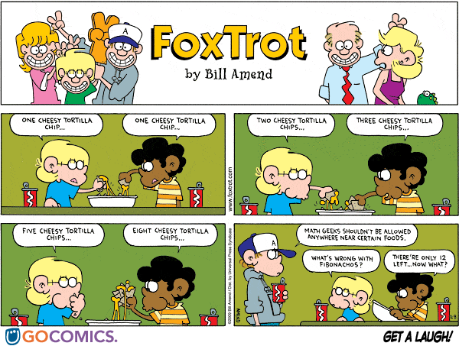

Slide 5
Recursive Fibonacci
public static int fibo( int n) { if (n == 1 || n == 2) return 1; return fibo(n-1) + fibo(n-2); }
Seems like a great idea – but every time we ask for the next term, the amount of work doubles, creating an exponential function O(2^{n})! Yuck!

Slide 6
Tracing Review
public static int trace1(int x, int y)
{
if (x < y)
return x;
return trace1(x - 1, y + 2) – y;
}
What is returned by trace1(10, 5)?
What is returned by trace1(6, -3)?

Slide 7
Tracing Review
public static String trace2(String str)
{
if (str.length() == 0)
return str;
String s = str.substring(1);
str = str + trace2(s);
return str;
}
What is returned by trace2(“abcde”)?

Slide 8
Tracing Review
public static void trace3(int x, int y)
{
if (x > y)
trace3(x - 2, y + 3);
System.out.println(x + " " + y);
}
What is displayed by trace3(21, 10)?

Slide 9
Mutual Recursion
Two or more methods complete a task by calling each other
Rarely used by most programmers, but difficult to trace

Slide 10
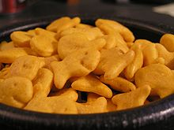
Doubling Goldfish
How do we double the number of goldfish in a mug without counting them?
Possible Operations:
Check if mug is empty
Move 1 goldfish from mug to infinite supply
Move 1 goldfish from infinite supply to mug

Slide 11
Use Recursion!
doubleGoldfish()
If mug not empty
Move 1 goldfish from mug to infinite supply
doubleGoldfish()
Move 1 goldfish from infinite supply to mug
Move 1 goldfish from infinite supply to mug

Slide 12
Thinking Recursively
Step 1: Consider various ways to simplify input
Compute problem for smaller value
Eliminate part of a list or set
Compute problem for string with one less character

Slide 13
Thinking Recursively
Step 2: Combine solution(s) for simpler inputs with original problem
5! = 5 * 4!
# descendants = # my children
+ # descendants of my children

Slide 14
Thinking Recursively
Step 3: Find solutions for the simplest inputs
1! = 1
# descendants of a childless person is 0

Slide 15
In PREFS update MEMO: HCS3 – period - Last, First
TEACHER SHARE (if needed): Robin.bailey@pisd.edu
www.codingbat.com Java: Recursion 1
sumDigits
Due by MIDNIGHT, Thursday, 2/10/2023
count8
changeXY

Slide 16
Recursive Helper Methods
Sometimes need additional information that a client should not have to provide (parameters)
Create a helper method that does the recursive work

Slide 17
Binary Search
Need a termination (base or exit case) to stop the recursion – these are special cases for simplest values in computation
If section of list is undefined, target not found (return -1)
Check middle of given section of list
Need a recursive call for a simpler computation to help complete this computation
If match, return index
If search value is smaller than middle, continue search in left half of list
Otherwise, continue search in right half of list

Slide 18
Efficiency of Recursion
In most cases, recursion runs only slightly slower than its iterative counterpart
Exception: Fibonacci because it computes same values over and over and over again
Each recursive call makes some extra work by adding entry to internal call stack
Physical limit to number of entries placed on internal call stack

Slide 19
When Should I Use Recursion?
If the problem can be solved easily using iteration, use iteration
Recursive solutions are often elegant – short and easy to understand
Use recursion when iterative solution is too complex
Use recursion when it’s the only way

Slide 20
Backtracking
Algorithm for finding solutions to a problem by exploring possible candidate solutions and abandoning (“backtracking”) once a candidate solutions is not suitable
Can use recursion or a stack to solve – can be overly time consuming

Slide 21
Find the number of dollar signs connected to [0,0], moving horizontally and vertically (not diagonally)
$ | * | $ | * | $
$ | $ | $ | * | $
* | $ | * | * | *
* | * | * | $ | *
* | * | $ | $ | *
* | $ | $ | * | *
* | * | * | * | $
[0,0] has a $, so it has 1 plus the number found at [0,1] [1,0]
[0,1] has no $, so we’re done
[1,0] has 1 plus how many found at [0,0] [1,1] [2,0] – already checked [0,0]
Need to mark a location “visited” before checking adjacent cells

Slide 22
Find the number of dollar signs connected to [0,0], moving horizontally and vertically (not diagonally)
$ | * | $ | * | $
$ | $ | $ | * | $
* | $ | * | * | *
* | * | * | $ | *
* | * | $ | $ | *
* | $ | $ | * | *
* | * | * | * | $
Start at [0,0] – it’s a $ so mark it then check adjacent cells
[0,1] has no $, so we’re done
[1,0] is a $ so mark it then check its adjacent cells
Skip [0,0] & check [1,1] – it’s a $ mark it then check adjacent cells
Continue until all adjacent cells with $ have been checked

Slide 23
Backtracking
Explore all possibilities
If no more possibilities, we’re done
Otherwise….
Try Possibility P, remove from possibilities group
Explore all other possibilities
Put Possibility P back in group of possibilities

Slide 24
Backtracking Strategies
What are the “possibilities” in this problem?
How do I know when I’m out of possibilities? (Base case)
How do I choose a possibility?
Do I need to create additional variables to remember my previous choices?
Do I need to modify existing variables?

Slide 25
Backtracking Strategies
How do I explore the remaining possibilities?
Do I need to remove this choice before exploring others?
What changes for the recursive call?
What do I do when I’m finished exploring the rest?
If I removed this choice, how do I put it back?
Do I need to put it back?
Thanks to Marty Stepp & Stuart Reges!

Slide 26
Permutations of a String
Suppose we want to generate all permutations of a given string
Permutations: rearranging of all letters
“eat” – eat, eta, aet, ate, tea, tae

Slide 27
Permutations of a String
Generate all permutations that start with ‘e’, then ‘a’, and then ‘t’
Join ‘e’ with all permutations of “at”
Join ‘a’ with all permutations of “t”
Repeat with ‘a’ and ‘t’

Slide 28
String Permutations Algorithm
Simplest case: 0- or 1-character string is its own permutation
Loop through each character in the string
Create smaller word by removing this character
Generate the smaller word’s permutations
Add this character to beginning of smaller word’s permutations and add to return list
Return all permutations

Slide 29
www.codingbat.com Java: Recursion 1
changePi
Due by MIDNIGHT, Wednesday, 2/12/2023
noX
pairStar

Slide 30
Practice-It!
UW CSE 143 (CS2) Recursion Tracing, Recursion, Recursive Backtracking
Building Java Programs Ch 12 Recursion

